Slide 1
Lec 5 4th stage
Organic Pharmaceutical Chemistry III
2018-2019
Assist prof. Dr.Rita Sabah Elias
College of Pharmacy, university of Basrah
Textbook of Organic medicinal and pharmaceutical chemistry
Wilson and Gisvold’s

Slide 2
β-Lactamase inhibitors
There are two classes of β-lactamase inhibitors:-
Class I inhibitors that have a heteroatom leaving group at position 1 (e.g., clavulanic acid and sulbactam).
Class II inhibitors that do not (e.g., the carbapenems).
mechanism-based inhibitors react with the enzyme in much the same way that the substrate does. With the β-lactamases, an acyl-enzyme intermediate is formed by reaction of the β-lactam with an active-site serine hydroxyl group of the enzyme.
For normal substrates, the acyl-enzyme intermediate readily undergoes hydrolysis, destroying the substrate and freeing the enzyme to attack more substrate.
The acyl-enzyme intermediate formed when a mechanism-based inhibitor is attacked by the enzyme is diverted by tautomerism to a more stable imine form that hydrolyzes more slowly to eventually free the enzyme (transient inhibition), or for a class I inhibitor, a second group on the enzyme may be attacked to inactivate it.
Because these inhibitors are also substrates for the enzymes that they inactivate, they are sometimes referred to as “suicide substrates.

Slide 3
Mechanism based inhibition of β-lactamase

Slide 4
Because class I inhibitors cause prolonged inactivation of certain β-lactamases, they are particularly useful in combination with extended-spectrum, β-lactamase-sensitive penicillins to treat infections caused by β-lactamase-producing bacteria. Three such inhibitors:-
Clavulanic acid.
Sulbactam.
Tazobactam.
A class II inhibitor:-
The carbapenem derivative imipenem, has potent antibacterial activity in addition to its ability to cause transient inhibition of some β-lactamases.

Slide 5
Products
Clavulanate Potassium
it is a 1-oxopenam lacking the 6-acylamino side chain of penicillins but possessing a 2-hydroxyethylidene moiety at C-2.
Used in combination with amoxicillin (Augmentin).
Exhibit very weak antibacterial activity.

Slide 6
Sulbactam
It is penicillanic acid sulfone or 1,1-dioxopenicillanic acid.
Potent β-lactamase inhibitor.
Weak antibacterial activity.

Slide 7
Tazobactam
Its sulfone β-lactam, that is similar in structure to sulbactam in which one of the methyl group at 2- position replaced by triazomethylene (penicillanic acid sulfon).
It is a more potent β-lactamase inhibitor than sulbactam.
It has a slightly broader spectrum of activity than clavulanic acid
Combine with piperacillin (Zosyn) Approved indications for appendicitis, postpartum endometritis, and pelvic inflammatory disease caused by β-lactamase-producing E. coli and Bacteroides spp.

Slide 8
Cephalosporins
The cephalosporins are β-lactam antibiotics isolated from Cephalosporium spp. or prepared semi synthetically.

Slide 9
Classification
Cephalosporins are divided into first-, second-, third-, and fourth-generation agents, based roughly on their time of discovery and their antimicrobial properties In general, progression from first to fourth generation is associated with a broadening of the Gram-negative antibacterial spectrum, some reduction in activity against Gram-positive organisms, and enhanced resistance to β-lactamases.
First generation:- show good G+ activity, modest G- and poor resistance to β-lactamase (cephalexin, cefazolin, cefadroxil).
Second generation:- showed increase in G- activity and modest activity against G+ organism( cefuroxime, cefonacid, cefamondole, cefoxitine, others ) and with good resistance to β-lactamase.
Third generation:- showed greatest activity than first and second generaion against G- microorganism with good resistance to β-lactamase( maxobactam, cetizoxime, others)
Fourth generation:- showed comparable activity to third generation but more resistant to some β-lactamase (cefepim).

Slide 10
Nomenclature
The chemical nomenclature of the cephalosporins is slightly more complex than even that of the penicillins because of the presence of a double bond in the dihydrothiazine ring.
The fused ring system is designated as 1-thia-5-azabicyclo[4.2.0]oct-3-ene
Named as 3-cephems(or Δ³-cephems to designate the position of the double bond), where
cepham represents the dihydrothiazine fused to β-lactam.
Penicillin analogs where the thiazolidine in penicillins has been replaced by dihydrothiazine.

Slide 11
The β-lactam in the cephalosporins is more stable to acid hydrolysis than that observed in penicillins due to decrease in ring strain and due to delocalization of the nitrogen lone pair into the double bond of the dihydrothiazine ring which decreases its basicity, thus decrease protonation of nitrogen.
The C-3 acetoxylmethyl function found in natural cephalosporin C and some of semi synthetic derivatives undergoes acid-catalyzed hydrolysis to form the corresponding allylic alcohol which lactonizes with the carboxyl function at C-4, these lactones are inactive for this reason cephalosporins with C-3 acetoxylmethyl substituent are orally inactive.

Slide 13
Chemical Degradation
Among 7-acylaminocephalosporanic acid derivatives, the 3-acetoxylmethyl group is the most reactive site.
In addition to its reactivity to nucleophilic displacement reactions, the acetoxyl function of this group readily undergoes solvolysis in strongly acidic solutions to form the desacetylcephalosporin derivatives. The latter lactonize to form the desacetylcephalosporin lactones, which are virtually inactive.
The 7-acylamino group of some cephalosporins can also be hydrolyzed under enzymatic (acylases) and, possibly, nonenzymatic conditions to give 7-ACA (or 7-ADCA) derivatives. Following hydrolysis or solvolysis of the 3-acetoxymethyl group, 7-ACA also lactonizes under acidic conditions .
The reactive functionality common to all cephalosporins is the β _-lactam. Hydrolysis of theβ _-lactam of cephalosporins is believed to give initially cephalosporoic acids (in which the R_ group is stable, [e.g., R_ _ H or S heterocycle]) or possibly anhydrodesacetylcephalosporoic acids (7-ADCA, for the 7-acylaminocephalosporanic acids).

Slide 14
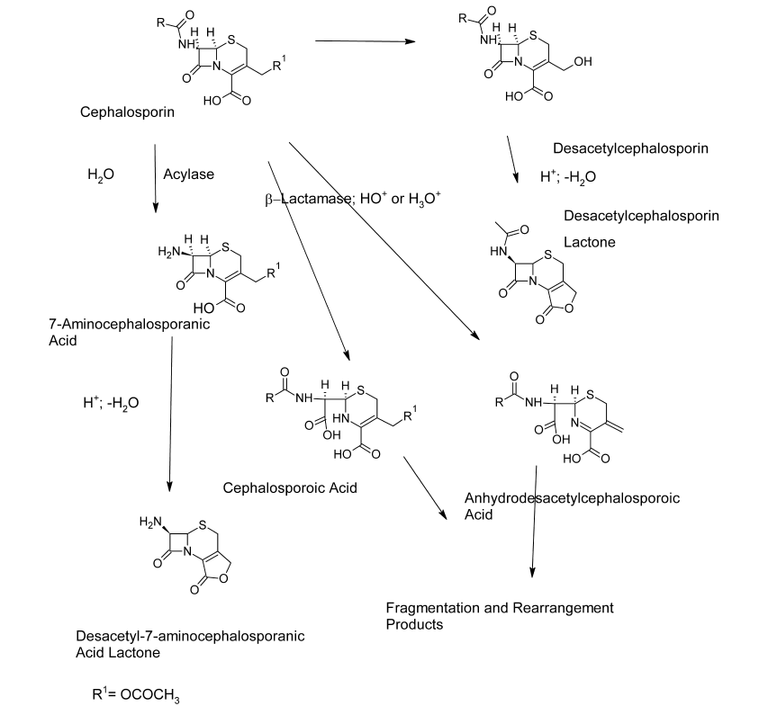

Slide 15
SAR of Cephalosporine
The absence of the leaving group on the allylic group at the 3-position → ↑acidic stability and oral activity.
The presence of amino group at α-carbon→↑ acidic stability and oral activity.
Increase stability to β-lactamase
Methoxyl substituent at the 7-position of the cephem nucleus →↑ resistance to β-lactamase.
alkoximino function in the aminoacyl group →↑ resistance to β-lactamase.
The introduction of polar substituents in the aminoacyl moiety of cephalosporins (on the α-carbon) NH2, OCH3,OH, COOH → not only increase spectrum of activity but also generally increase stability to some β-lactamases.
Cephalosporine are all developed as their sodium salts.
All cephalosporins are bactericidal.

Slide 16
Products
Cephalexin
Cephalexin, 7α-(D-amino-α-phenylacetamido)-3-methylcephemcarboxylic Acid, was designed purposely as an orally active, semisynthetic cephalosporin.
The α-amino group of cephalexin renders it acid stable, and reduction of the 3-acetoxymethyl to a methyl group circumvents reaction at that site, so its orally active

Slide 17
Cephradine
It closely resembles cephalexin chemically (it may be regarded as a partially hydrogenated derivative of cephalexin) and has very similar antibacterial and pharmacokinetic properties
Cefadroxil
p-OH derivative of cephalexin
The antibacterial spectrum of action and therapeutic indications of cefadroxil are very similar to those of cephalexin and cephradine.

Slide 18
Cefaclor is an orally active semisynthetic cephalosporin .It differs structurally from cephalexin in that the 3- methyl group has been replaced by a chlorine atom. Its orally active.
Cefprozil
Cefprozil is an orally active second-generation cephalosporin that is similar in structure and antibacterial spectrum to cefadroxil. Oral absorption is excellent.

Slide 19
Loracarbef
Loracarbef (Lorabid) is the first of a series of carbacephems prepared by total synthesis to be introduced. Carbacephems are isosteres of the cephalosporin (or Δ³-cephem) antibioticsin which the 1-sulfur atom has been replaced by a methylene (CH2) group. Loracarbef is isosteric with cefaclor and has similar pharmacokinetic and microbiological properties.

